Slide 1
Image Similarity
Personal Proyect

Slide 2
Deep Learning Models
Clip
Inception
YOLO (v3)

Slide 3
NoSQL Graph Database Storage
Neo4J

Slide 4
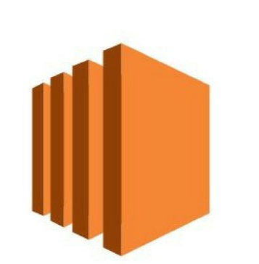





Model Deployment
Clone Repository
Dockerize App
Hosting
Accessing APP
Amazon EC2
Amazon ECR
AWS Fargate

